Slide 1
Detection of DNS attacks using Hidden Markov Model
Student Researcher: Balaji Bharatwaj M (CB.EN.U4CSE16607), Aditya Reddy M (CB.EN.U4CSE17431)
Research Supervisor: Dr. Senthil Kumar T (Associate Professor)
Lead: Sulakshan Vajipayajula, Architect - CTO, IBM security, Bangalore

Slide 2
Keywords
Problem Statement
DDoS - Distributed Denial of Service
DoS - Denial of Service
HMM - Hidden Markov Model
KNN - K-Nearest Neighbours
The aim of this project is to detect attacks based on DNS (Ex. DDoS, DoS etc.) using HMM. The results shows how Hidden Markov Model performs with other clustering/classification algorithm like Logistic Regression and KNN.

Slide 3
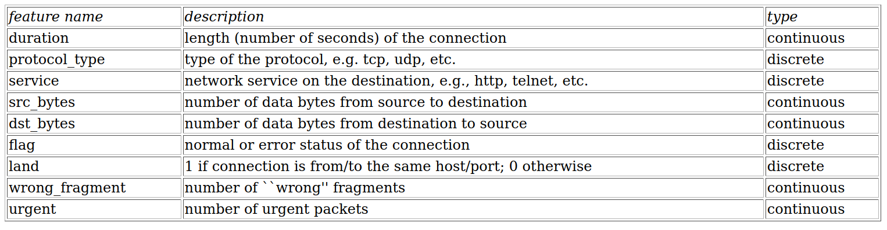
Dataset Features

Slide 4
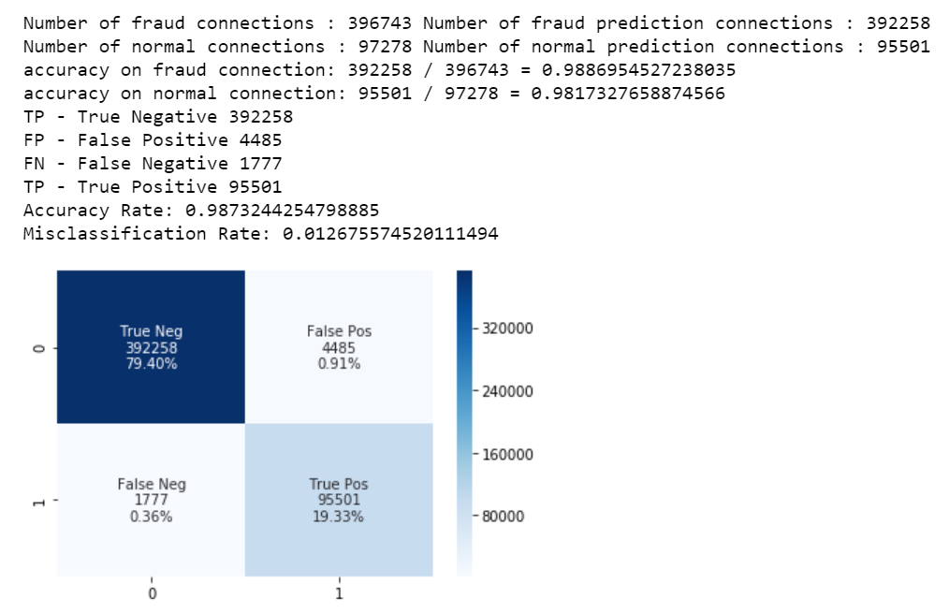
Performance with Logistic Regression

Slide 5
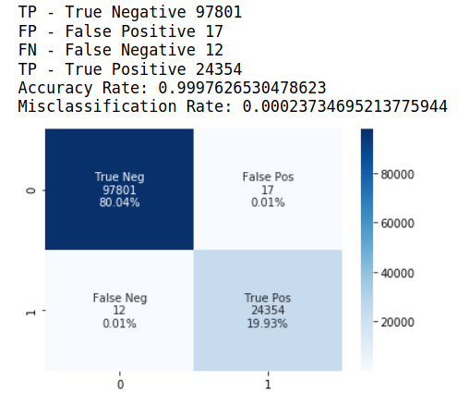
Performance with KNN

Slide 6
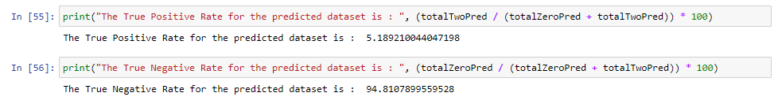
Performance with HMM
True Negative 94.8% | False Positive 0.05%
False Negative 0.05% | True Positive 5.1%

Slide 7
Final Conclusion
It’s evident that the Hidden Markov Model (HMM) performs better than the Logistic Regression Algorithm, and KNN Algorithm. The True Negative Rate (Negative value in the dataset and the predicted data is also negative) is 94.8% whereas the Logistic Regression and KNN has a True Negative Rate of 79.4% and 80.04% respectively.

